Slide 1



Slide 2
DESCRIPTION OF WORK OF EACH MEMBER
REVELLI RISHITHA PRASANNA
HTML : Code for HTML main casual page like album personal etc.
CSS : Design for full home page at marquee tag for sliding .
SANAGAPALLI.JASWANTH
HTML:code for html and image src tag and div tags
CSS: padding and align tags and font tags

Slide 3

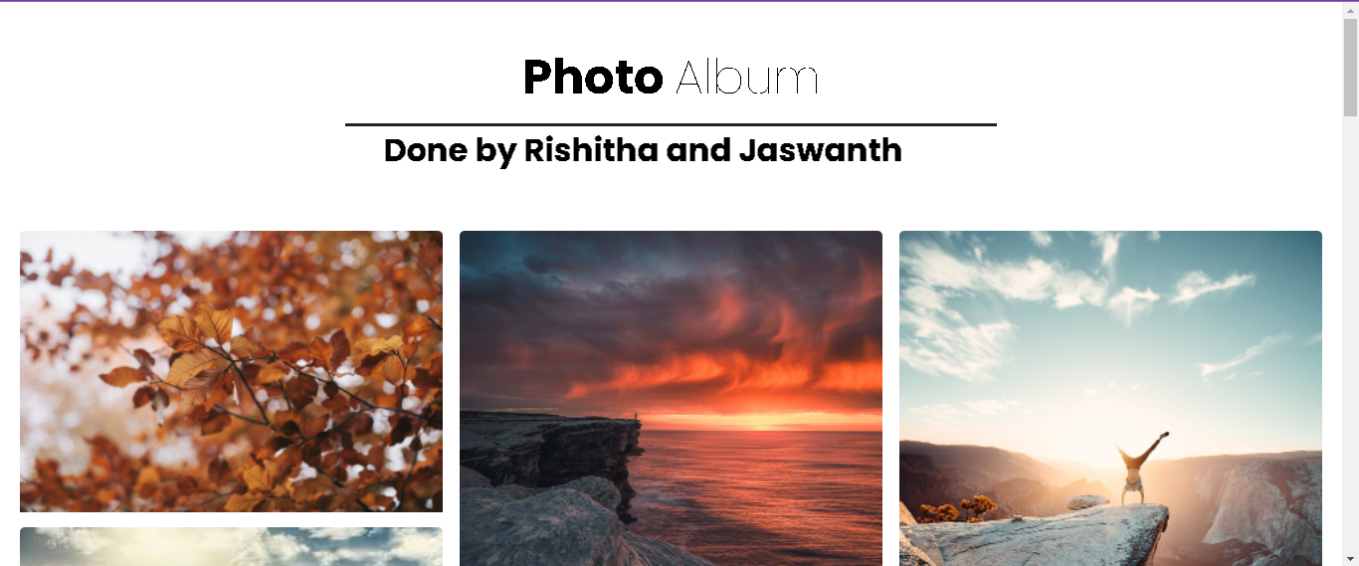
Tags used:Html,head,link,style,body,h1,form,image src,table,tr ,td,,background colour,div,button,input,label,keyframe,marquee,bold,arial black,span,dd.

Slide 4

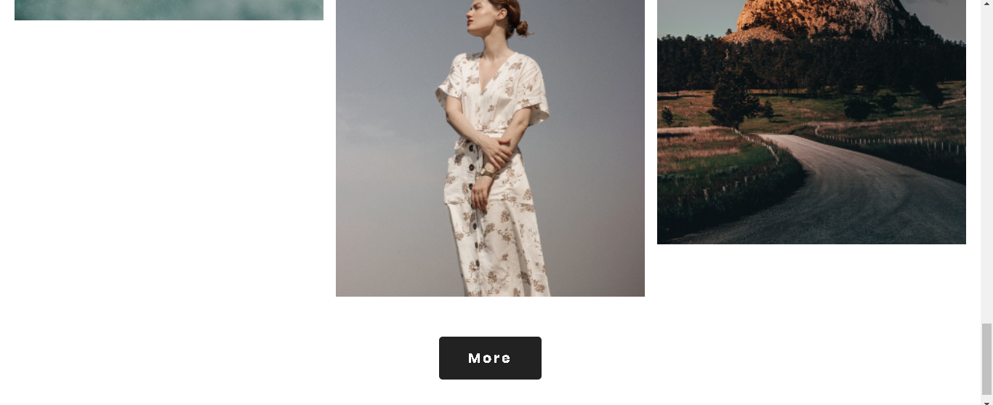
SIMILARLY THIS, WE HAVE PERSONAL PICTURES

